Slide 1
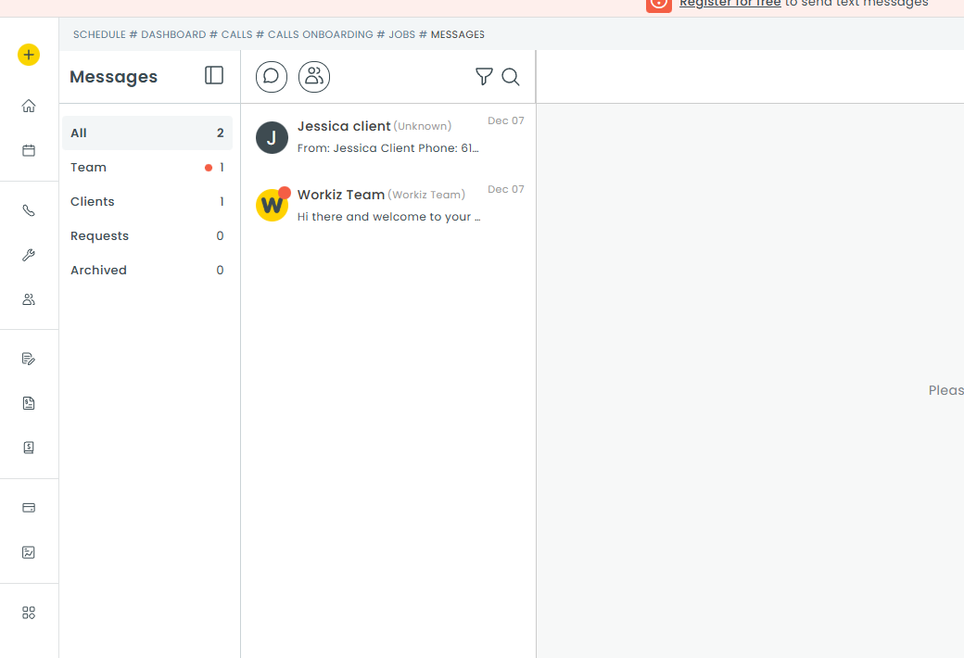
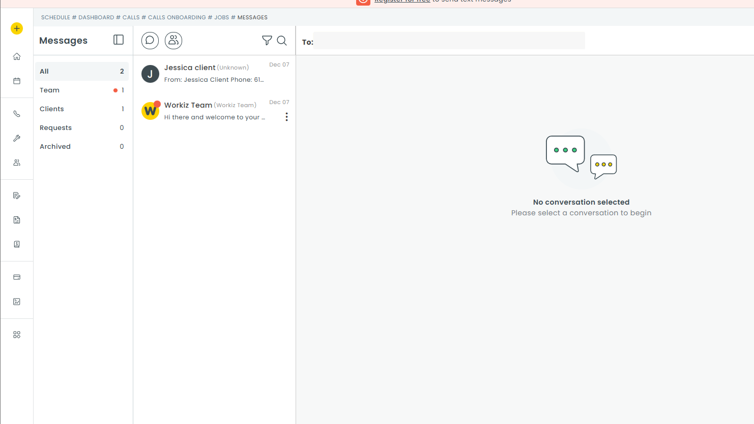
Opens the SMART contact search bar on the main panel
Add New Group
Write on message status
Search message
Smart search Bar

Slide 2
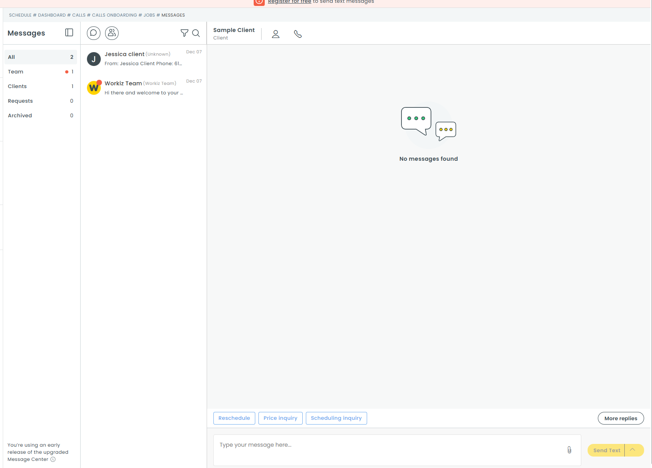
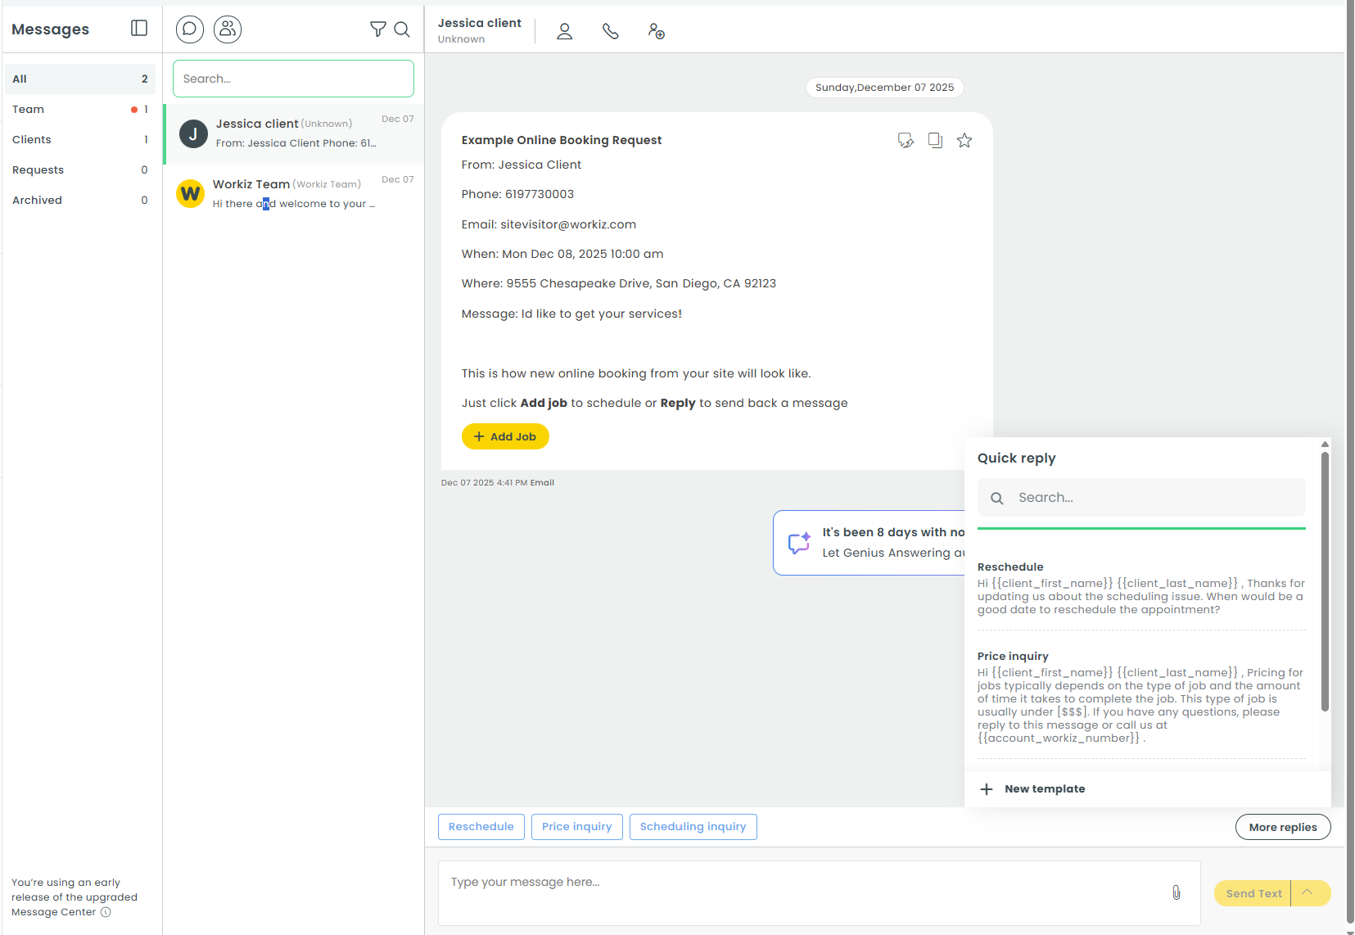
Opens contact info on side bar on the right
Call client
Add contact to the conservation
Smart action as follow next step to message
Open Quick replys
Type Message

